Slide 1

Grouped & Composite Rules
Scaling Rules with Sets, Groups & Dependencies
Presented by: Treveshan Naidoo
TTD Consulting Internal Learning Series

Slide 2
Welcome
Quick recap of Week 5: decisions, severity, and testing
This week: grouping rules, composite sets, and scenario-based evaluation
Notes:
Last week, we introduced outcomes like Approve or Reject. Now, we focus on organizing rules into groups for different products, scenarios, or dependencies.

Slide 3
Why Group Rules?
Real systems = hundreds of rules
Not all rules apply to all products/users
Improves performance and clarity
Rule sets give context:
Life Insurance Rules
Funeral Cover Rules
Notes:
Think of underwriting for 3 products. You don’t want to run every rule for every application just the relevant ones. That’s what grouping lets us do.

Slide 4
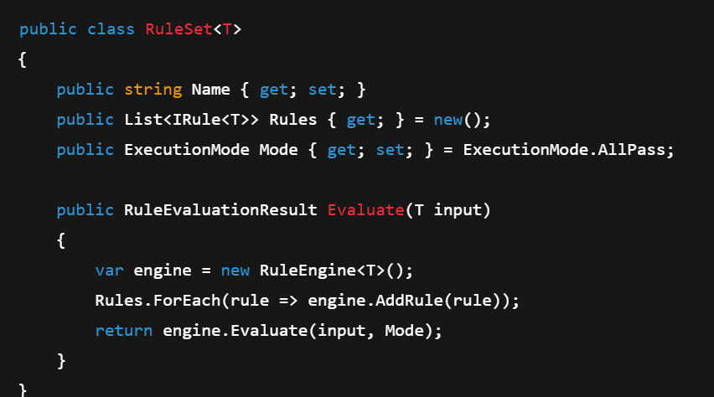
Introducing RuleSet<T>
Notes:
Each RuleSet has a name, rules, and a mode AllPass, FirstFail, or Scored. You can define a set for each product, policy type, or region.

Slide 5
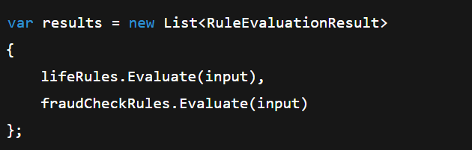
Composite Execution Logic
You can execute multiple RuleSets
Attach them to business flows:
Notes:
This allows you to evaluate related sets of rules independently then decide based on combined results. Useful for layering e.g. product rules + fraud checks + compliance.

Slide 6
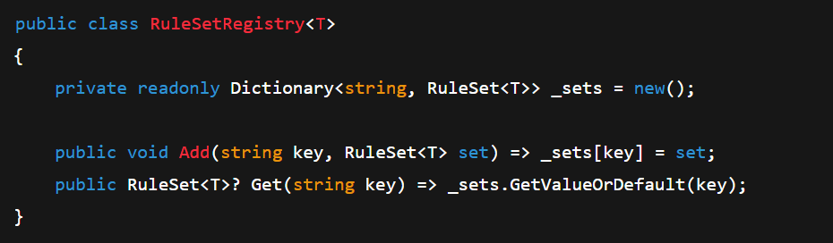
RuleSet Registry
Register rule sets centrally
Lookup by name, product type, etc.
Notes:
You might load RuleSets by product ID, region, or plan type. The registry pattern allows this cleanly and keeps rule loading dynamic.

Slide 7
Exercise Instructions
Goal: Group and execute rules by product
Create 2 RuleSet<UnderwritingInput> groups:
LifeCoverRules
FuneralCoverRules
Each with different rule combinations
Run both and compare results
Notes:
You’ll create grouped rules and see how different combinations produce different results. Great for multi-product logic!

Slide 8
Outcome of This Week
You now group rules into named RuleSets
You can execute multiple sets per flow
You can register and lookup RuleSets dynamically
Foundation laid for scenario-based evaluation
Notes:
You’re now thinking at a higher level rules are no longer one giant list. They’re grouped, modular, and reusable.

Slide 9
Thank You

